Slide 1
Welcome to the CSP Scottish Board Webinar Delivering Alternative Placements: challenges and opportunities

Slide 2
Housekeeping
Please put mics to mute
Presentations from this session are being recorded and will be shared afterwards on iCSP and via Eventbrite (feel free to turn your camera off)
Please use the chat box to introduce yourself and also to make any questions or comments (please put questions as they occur to you through the presentations in the chat box and we will return to these at the end)

Slide 3
CSP Scottish Board – Alternative Practice Placement Models – LD pathways and competency development by Peer Assisted Learning (PAL) Students
Grant McCorrie
Edinburgh and West Lothian Community Learning Disability Physiotherapy Head of Service.
Jan 2025

Slide 4
Learning Disabilities – A brief history
From - the Lunacy Act 1845.
To - 2025 - Integrated Joint Boards (IJB) Public Bodies (Joint Working) (Scotland) Act 2014.
What we do – MDT/Specialist Ax, Treatment, Management for adults whose needs cannot be met, even with reasonable adjustment.
Transition from paediatric specialist education to older adults

Slide 5
Background The Benefits.
Policy Drivers –
CSP Pillars of Practice,
AfC Essential, Core and Role Specific Mandatory Training
Quality Strategy –
Timeline, Category of care Intermediate and long term Outcomes, reduce variance in healthcare
‘Poor health outcomes, shorter life expectancy and premature death’
CSP. Heslop et al 2013
Collaboration in skills building
Align clinical practice with guidelines
Reduce variation
Maximise outcomes – Time Management
Students – Reduced anxiety. Sense of safety. Immersive learning. Cohesive relationship. Reduced dependency
Ensure students and physiotherapists significantly influence the delivery of health care

Slide 6
Peer Assisted Learning (PAL) in action
MSK, Respiratory and Neurology practice…BUT in the context of LD
Criticism
MDT working
Interprofessional Education
Recognise skill set and consolidate learning
Current guidelines and competency
Assessment process in LD and neurodivergence
The CPAF - 4 key parts
Learning Agreement
Professional Behaviours & Responsibilities
Learning Domains
Feedback from Others
LD – Too complex
Time consuming and additional support
Difficult to evaluate
Lack of research – Evidence base
Implementation
Potential conflicts

Slide 7
‘Absence of Evidence is not Evidence of Absence’ Carl Sagan
Students chose to construct
MSK Knee Competency/Ax
They produced
Current advanced practice - MSK
ACPPLD current resource - iCSP – Network
Aim: To effectively assess and manage pain in the knee area
Learning Outcomes:
To have good knowledge of functional knee anatomy
To understand the structure and function in this area
To understand the biomechanics of normal movement
To understand the effects of aging on the knee complex
To have knowledge of specific and more common knee pathologies and how these affect patients (in terms of aetiology, pathophysiology, signs and symptoms, diagnostic tests prognosis, interventions)
Co-ordinated approach in LD Ax
Communication of findings in an LD context
Support, lifestyle and special tests.
Pain management - Integration of distress
tools – DisDat
Notes:
7

Slide 9
Moving forward……
The benefits to both students and service
Formal discussion - LD Network Forum
Clinical Governance NHS Lothian
QMU – Scientific poster and outline of LD services.
CoE – Define clear design and best practice
Team strengths – SENSE framework
Q – Pulse – Compliance, quality and safety processes.

Slide 10
Questions

Slide 11
Peer Assisted Learning: Our Experience of 4:1 Model
Ashley Johnstone
Ashley.johnstone2@nhs.scot
Acting Physiotherapy Head of Service
Royal Hospital for Children, Glasgow
January 2025

Slide 12
What is Peer Assisted Learning?
“the development of knowledge and skill through active help and support among status equals or matched companions”
Carr, S.E., Brand, G., Wei, L. et al. “Helping someone with a skill sharpens it in your own mind”: a mixed method study exploring health professions students experiences of Peer Assisted Learning (PAL). BMC Med Educ 16, 48 (2016). https://doi.org/10.1186/s12909-016-0566-8
AHP Peer Assisted Learning (PAL) placements | Turas | Learn

Slide 13
Our Placement Model
Vision of Kath Sharp for the service to embrace peer assisted learning
Paediatric physiotherapy respiratory placement
Student Team of 2:1 - 6:1
Variations on the number of students onsite during pandemic
Embraced use of Digital

Slide 14
A Typical Morning…
Time | Activity
8.30am | Respiratory Team Huddle: discuss team plan for day, patient allocation and learning opportunities.
9am | Student Team Huddle with PE: Make a plan for the morning, patient allocation, identify learning needs, tasks delegated / agreed.
10am | Student Team Huddle with PE: Feedback on learning / evidence base, status of patients, make plan for seeing patients.
10.30am | See patients, team effort with both virtual and onsite students actively involved in consultation and treatment session. Support from PE as required.
11.30am | Student Team Huddle with PE to debrief and reflect on consultations.
12pm | Everyone writes up a set of notes to share with PE for feedback.

Slide 15
Student Perspective
Clinical reasoning together and exploring a variety of treatment techniques allowed me to increase my confidence in handling and treating paediatric patients.
This model allowed us as students to share previous experiences and knowledge amongst one another which created a positive learning environment
Having the ability to problem solve with my peers was a particular aspect of the 4:1 model that really appealed to me. This enabled me to report back to my practice educators more confidently yet still feel comfortable to ask any unresolved questions.

Slide 16
Practice Educator Perspective
My role has not been that of a teacher but as a guide to facilitate learning
It was a pleasure to observe students taking on the responsibility for their own learning and sharing their knowledge and experience with each other
Students thrive from the support of their peers to work competently and independently with their individual caseload

Slide 17
Conclusion: Peer Assisted Learning
Team work, opportunities for sharing answers, ideas, and perspectives, in a supportive environment
Promotes clinical reasoning and reflective practice
Promotes learning of softer skills in addition to technical skills
Increased confidence
Increased responsibility, autonomy and achievement
Prepares students to be life long learners
Prepares students to be part of the workforce
Tell me and I’ll forget,
teach me and I may remember,
involve me and I’ll learn.
Benjamin Franklin

Slide 18
CSP Scottish Board Webinar

Slide 19
BACKGROUND
Who are we?
ESP Physio | Elite Sporting Performance Ltd
Private MSK Physio Providers
4 clinics across central Scotland
We treat patients from all walks of life
initially specialised in sports injuries
Sporting Contracts
Stirling County RFC
Dollar Academy Rugby Teams
Growing company currently treat over 1000 patients per month

Slide 20
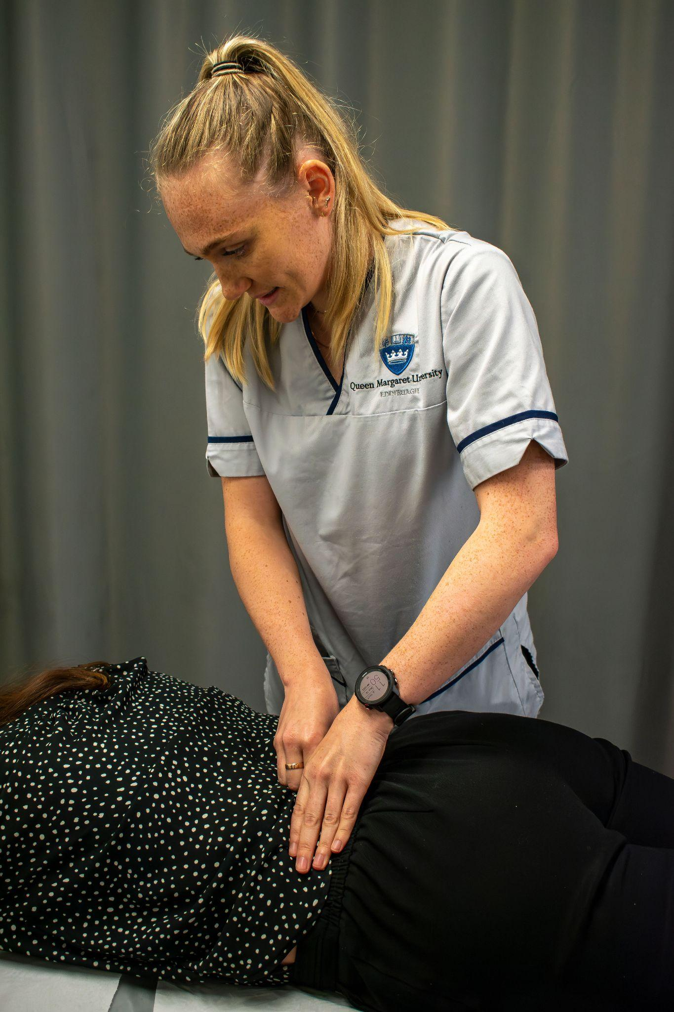
Why Take Students?
Give back to the profession
Help the new generation of clinicians
Support QMU
Add to our credibility as a company
Help our clinicians become better

Slide 21
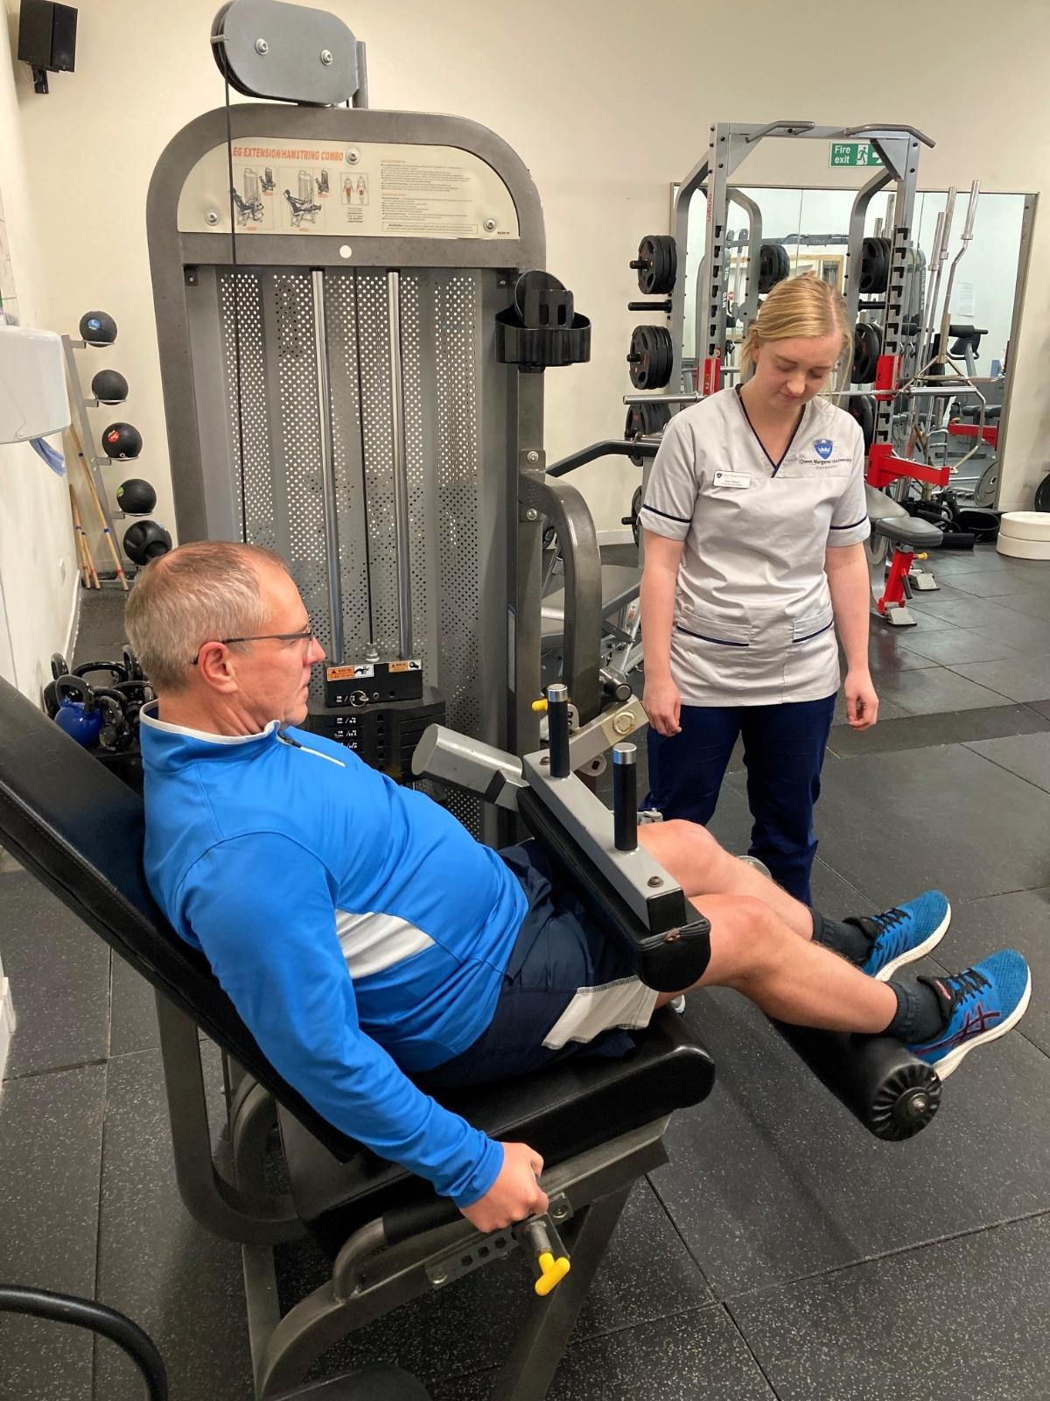
How We Work It
Started with QMU in 2016
Initially elective final year students
3 physio students per year
Demand Increased!
Now students at various stages
Elective students from across UK and Europe
Opened up to 2 students per block throughout the year

Slide 22
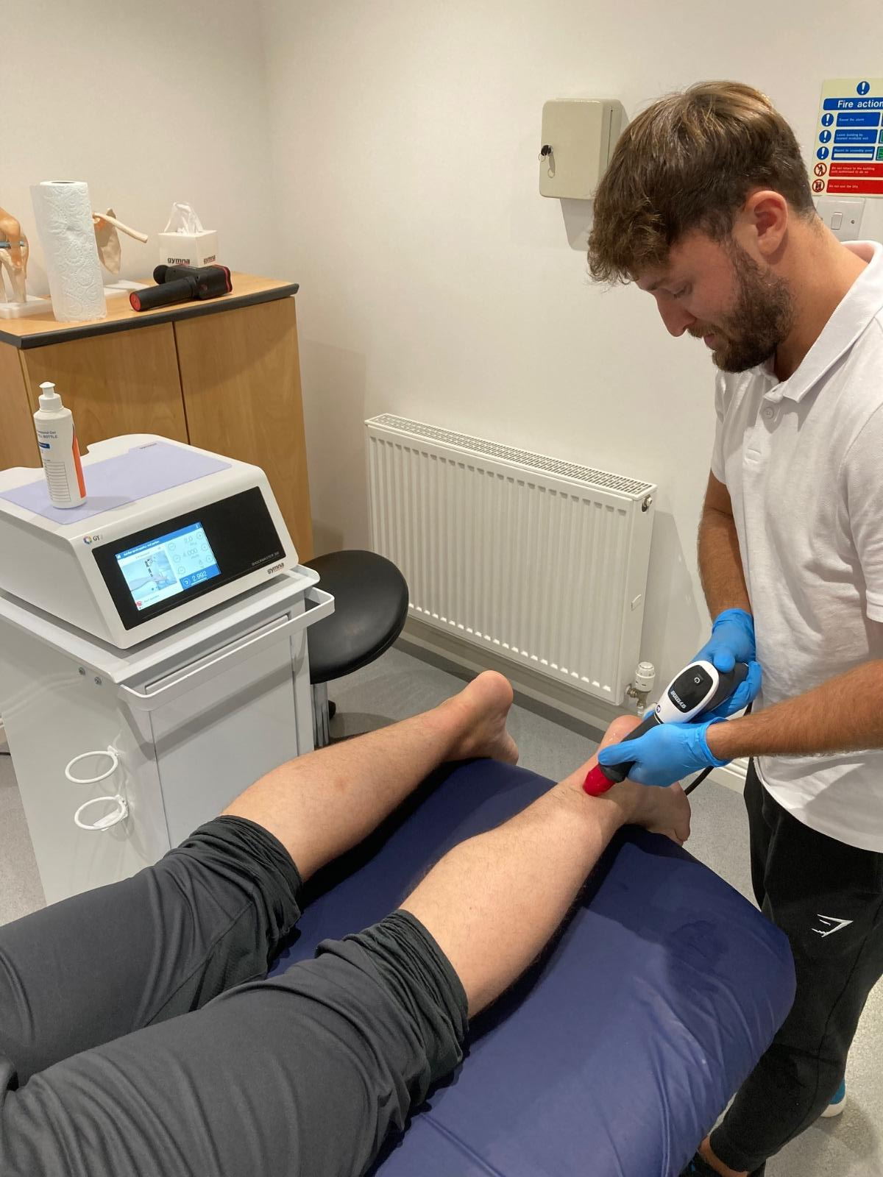
What A Placement Is Like?
Clinician-Led, Self-paced
Expectations set from day 1
Finish placement competent in Basic MSK assessment and reasoning
Students take charge of their own learning
Multiple clinicians with different background
Exposure to different clinical approaches, working to same end-goal

Slide 23
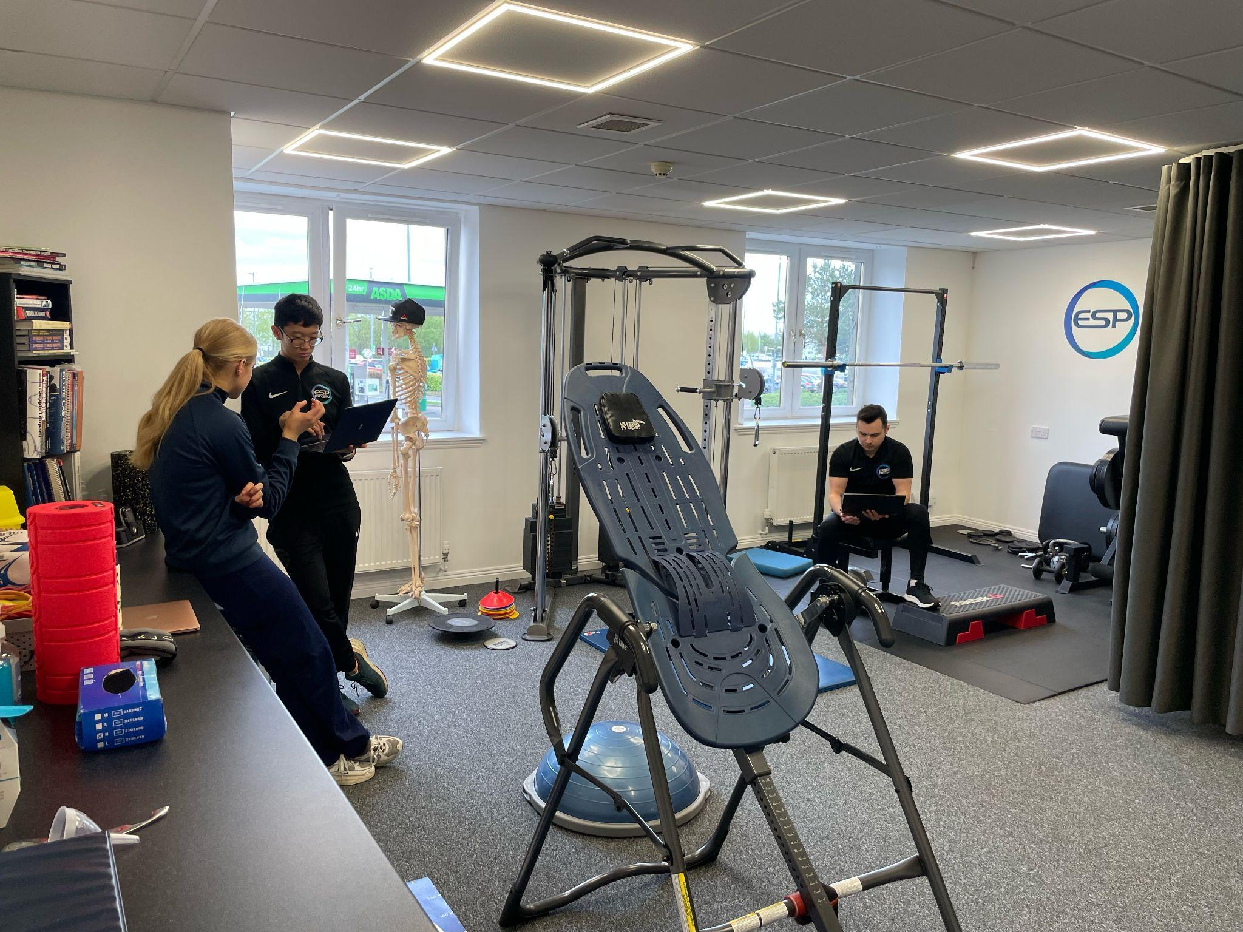
Challenges…
Co-ordinating the placements
Staffing - making sure we have enough cover for students when on placement
Time for our physio’s to provide mentoring and any admin

Slide 24
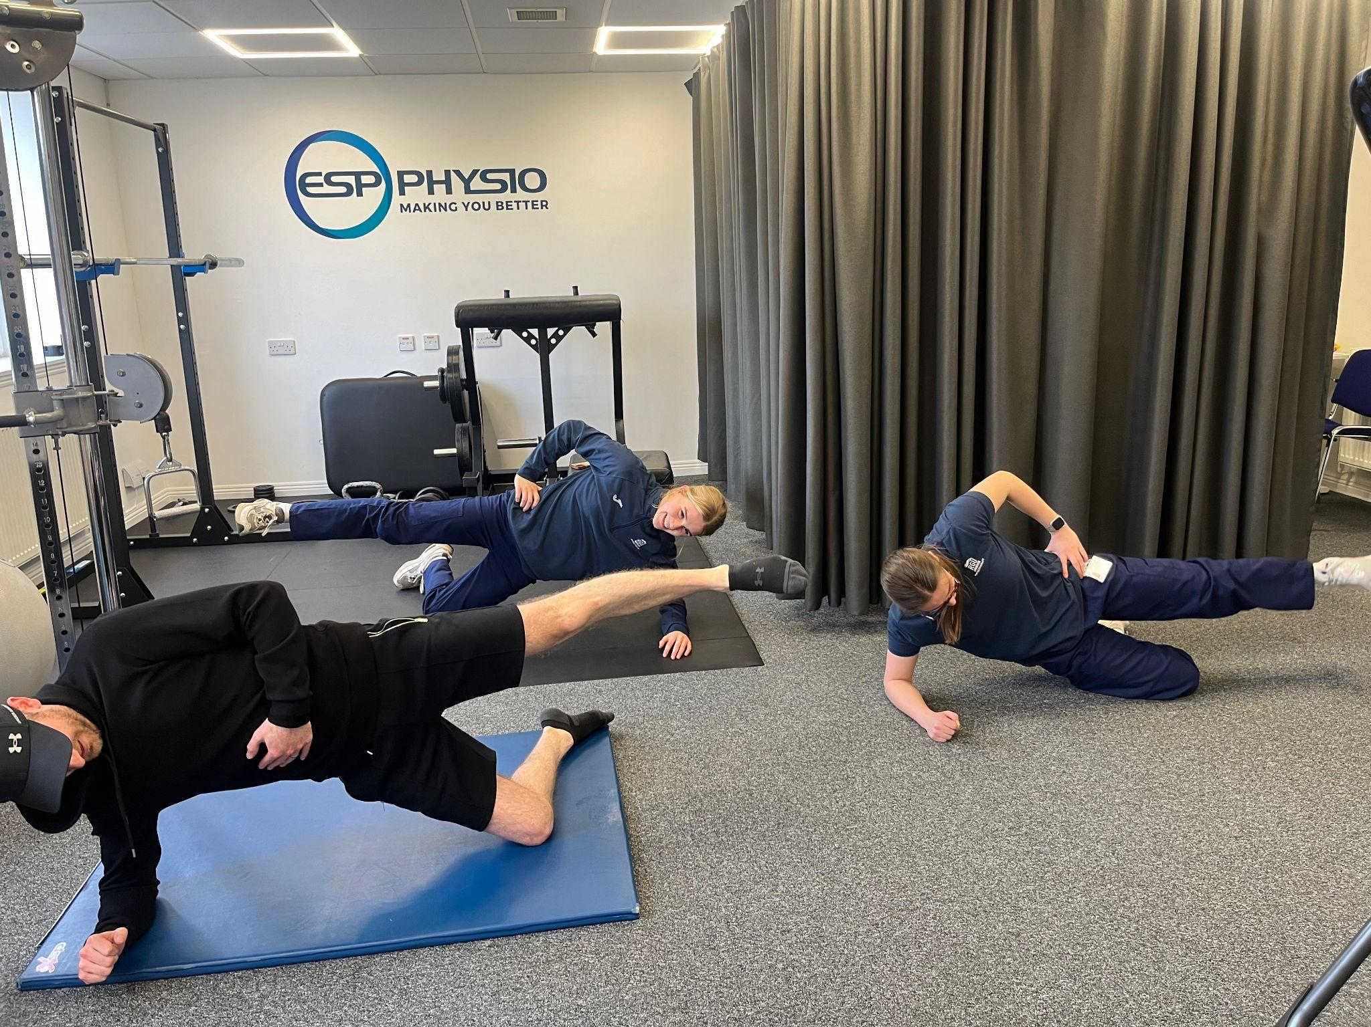
Benefits…
Students get a real experience of Private MSK Physio
Feedback is positive from all parties
Staff enjoy teaching and sharing experiences
Staff become more confident and upskill knowledge
Everyone wins

Slide 25
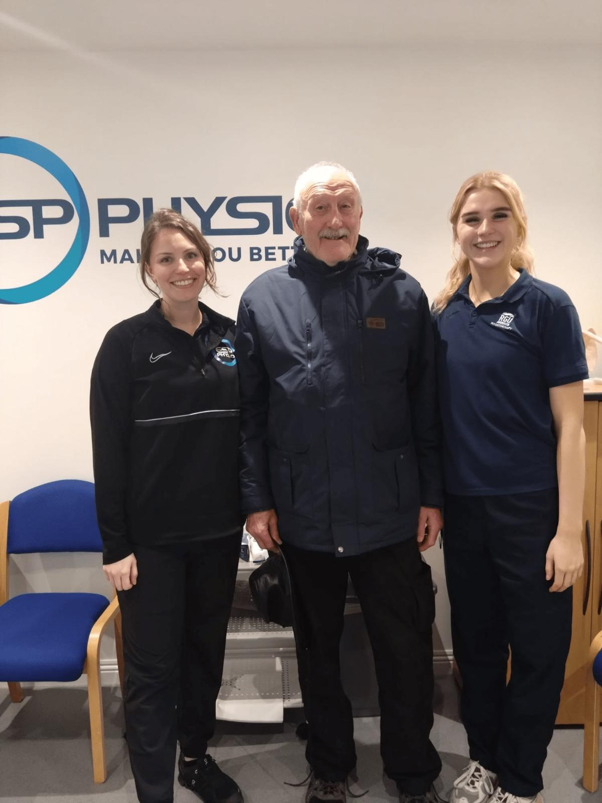
Questions?

Slide 26
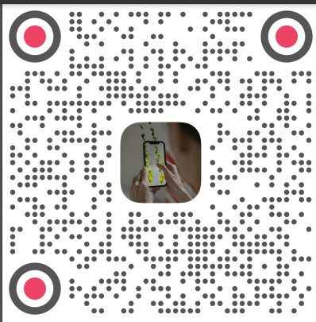
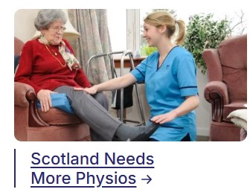
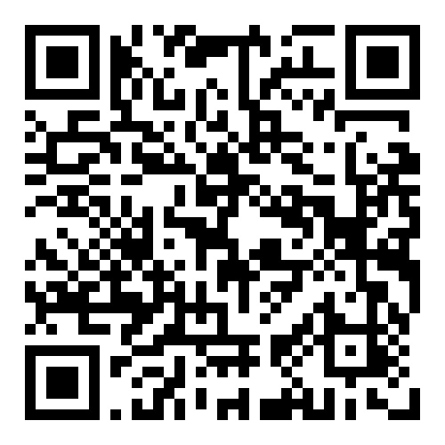
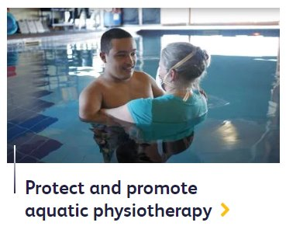
csp.org.uk/campaigns
#RightToRehab and the Community Rehabilitation coalition. Team Scotland working to lobby the next Scottish Government (attending Scottish Labour Conference 21 – 23 February)
Scotland needs more Physios –MSP letter writing campaign
Team Scotland campaigns driven by member need (including loss of rehabilitation space, loss of aquatic physiotherapy services and facilities)
Scan QR code above to view Alice’s Road to Recovery

Slide 27
Stay in touch with us
Web: https://www.csp.org.uk/networks/nations-regions/scotland/csp-scottish-board X: @ScotBoardCSP
CSP country emails: csp.org.uk/emailpreferences

