Slide 1
Using Population Data
bennettk@csp.org.uk
r
020 7306 6696
t
@thecsp
Kate Bennett, MCSP
Project Manager, Physiotherapy Works

Slide 2
Who is your population?
In groups consider the following 2 questions about your current role:
When you started in your role what was your main patient caseload?
What is your main patient caseload now i.e. how has your patient population changed (if it has)?

Slide 3
Where do you get your population data from?
CCG data
Public health profiles
How many of you have seen/ used them?

Slide 9
If your service was located in this CCG what could you be focusing on?

Slide 10
How to use population data tools
bennettk@csp.org.uk
r
020 7306 6696
t
@thecsp
Kate Bennett, MCSP
Project Manager, Physiotherapy Works

Slide 11
In the time it takes you to read this slide, an elderly person living in the UK will have had a fall
6.44 Seconds
O'Loughlin, Jennifer L., et al. "Incidence of and risk factors for falls and injurious falls among the community-dwelling elderly." American journal of epidemiology 137.3 (1993): 342-354.
Notes:
Population is aging – likely to live another 20 years over the age of 65
70% of hospital admissions are for older people yet 1 in 4 admissions are avoidable
Older people account for 70% of NHS expenditure but prevention, early intervention and rehabilitation can reduce that
Older people are often discharge with care packages that are costly which can be reduced or discontinued with effective rehabilitation
The case is similar with people with long term conditions. There are currently 15million people with LTCs in England
That’s 30% of the population and that is likely to rise to 18million by 2018.
This situation can be changed when in individuals needs are met. They don’t want repeated GP visits, unnecessary hospital admissions or to have to move into a care home.
Older people and people with LTC want to enjoy their lives, be kept independent and get back to independence as soon as possible after illness or injury.
It’s not just about quantity but quality of life.
Physiotherapy can help people live longer and live well!
We take an asset based approach building on what people can do
Physiotherapy builds resilience through offering self management programmes and direct access when needed
People need to be fit to work longer
They will also not be as available to provide the unpaid informal carer role that many older people, and others rely on. Another reason why we need to keep people living well and independently.
The economic purse to provide health and social care is shrinking all the time.
The situation within Health and Social Care is simply unsustainable

Slide 12
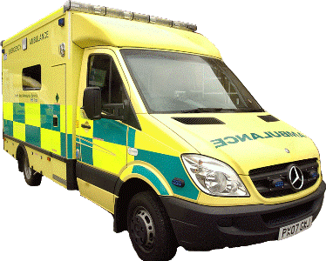
Every thirty seconds an elderly person has a fall serious enough to call out an ambulance
O'Loughlin, Jennifer L., et al. "Incidence of and risk factors for falls and injurious falls among the community-dwelling elderly." American journal of epidemiology 137.3 (1993): 342-354.
Notes:
Not always due to injury but unable to get up etc

Slide 13
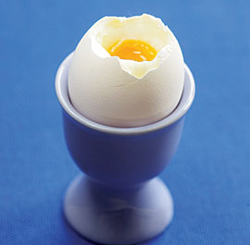
In the time it takes to soft boil an egg, an elderly person living in the UK will have had a fracture which was preventable with physiotherapy
O'Loughlin, Jennifer L., et al. "Incidence of and risk factors for falls and injurious falls among the community-dwelling elderly." American journal of epidemiology 137.3 (1993): 342-354.
Notes:
About 3.5 minutes

Slide 14
Someone in the UK dies of a hip fracture caused by a fall every hour
Age, U. K. "Stop falling: start saving lives and money." Age UK (2010).
Notes:
Approx 24 % of people suffering a hip fracture die within 3 months – Newcastle falls summit March 2015

Slide 15
The increase in falls has been the second biggest of any major disease area since 2000
Lopez, Alan D., and C. C. Murray. "The global burden of disease." Nat Med4.11 (1998): 1241-3.
Notes:
?? Why – any thoughts??
Increase in sedentary lifestyle?

Slide 16
One third of adults aged 65 or over will have a fall this year
O'Loughlin, Jennifer L., et al. "Incidence of and risk factors for falls and injurious falls among the community-dwelling elderly." American journal of epidemiology 137.3 (1993): 342-354.

Slide 17
12.4% of adults aged 65 or over will have a fall this year which is so serious they require hospitalisation
O'Loughlin, Jennifer L., et al. "Incidence of and risk factors for falls and injurious falls among the community-dwelling elderly." American journal of epidemiology 137.3 (1993): 342-354.
Notes:
1/3 of those adults/ 1/6 of that age group

Slide 18
Falls
Fractures
As far as patient experience is concerned, falls are just the tip of the iceberg – the fear of falling has a QALY burden of 6.4 times the total burden of falls and fractures in the elderly
Fear
of Falls
Iglesias, C. P., A. Manca, and D. J. Torgerson. "The health-related quality of life and cost implications of falls in elderly women." Osteoporosis international20.6 (2009): 869-878.
Notes:
What is a QALY?
The quality-adjusted life year is a measure of disease burden, including both the quality and the quantity of life lived.^{[1][2]} It is used in assessing the value for money of a medical intervention. So for the fear of falling is 6.4 times as debilitating as actually having a fall/ fracture in relation to QOL.

Slide 19
Falls
Fractures
At £30,000 per QALY, the NHS remains cost-effective even if it spends £2067 per 65 year old to prevent their falls and fear of falling
Fear
of Falls
Iglesias, C. P., A. Manca, and D. J. Torgerson. "The health-related quality of life and cost implications of falls in elderly women." Osteoporosis international20.6 (2009): 869-878.
Notes:
Fear of falling – decreased muscle strength, poor balance, lack of mobility and social isolation

Slide 20
Model Purpose
Answers the question, “Is physiotherapy a cost-effective way of preventing falls in a given elderly population?”
Answer is a resounding, “Yes” – physiotherapy can probably prevent around 225,000 serious falls and spend of £330m across the UK each year. For every £1 spent on physiotherapy, around £1.50 is returned in prevented NHS spending.
The principle underpinning the model is to use the highest-quality data publically available and – where assumptions have to be made – make the most conservative assumptions possible
Notes:
In 2014 CSP worked with the NHS Yorkshire and Humber commissioning support unit to produce a falls prevention economic model.

Slide 21
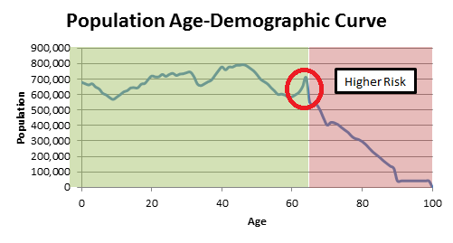
Urgently Needed
The graph above shows the population of England and the ages at which you are considered to be at ‘higher risk’ of falls (65+). It also demonstrates that a concentration of baby boomers are about to enter this high risk zone, which commissioners are not prepared for. For example, there could be a 19.2% increase in care home admissions triggered by a fall in the next five years!

Slide 22
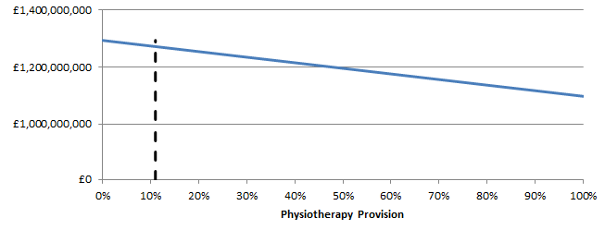
Cost-Effective
The graph above, taken from the economic model, shows that the NHS in England could save around £275m by commissioning physiotherapy to protect people from experiencing falls. This is on top of the huge population health benefits such commissioning would bring.

Slide 23
Savings
Region | Number of falls saved | Cost Saving (£)
England | 186,473 | 273,039,156
London | 19740 | 28,935,230
NHS Barking and Dagenham | 434 | 656,428
NHS Barnet | 1064 | 1,595,282
NHS Bexley | 816 | 1,221,095
NHS Brent | 688 | 989,225
NHS Bromley | 1159 | 1,739,088
NHS Camden | 515 | 745,500
NHS Central London (Westminster) | 410 | 598,997
NHS City and Hackney | 389 | 549,933
NHS Croyden | 970 | 1,419,735
NHS Ealing | 784 | 1,135,099
Notes:
Examples of regional savings that can be calculated using the model

Slide 24
Savings
Region | Number of falls saved | Cost Saving (£)
NHS Enfield | 839 | 1,235,509
NHS Greenwich | 572 | 835,596
NHS Hammersmith & Fulham | 349 | 496,618
NHS Haringey | 472 | 666,887
NHS Harrow | 733 | 1,084,623
NHS Havering | 936 | 1,412,402
NHS Hillingdon | 770 | 1,140,448
NHS Hounslow | 576 | 827,029
NHS Islington | 383 | 546,730
NHS Kingston | 460 | 683,050
NHS Lambeth | 494 | 712,100
Notes:
Examples of regional savings that can be calculated using the model

Slide 25
Savings
Region | Number of falls saved | Cost Saving (£)
NHS Lewisham | 570 | 836,177
NHS Merton | 510 | 751,945
NHS Newham | 437 | 619,354
NHS Redbridge | 744 | 1,105,762
NHS Richmond | 568 | 836,099
NHS Southwark | 482 | 694,287
NHS Sutton | 605 | 896,857
NHS Tower Hamlets | 335 | 488,489
NHS Waltham Forest | 560 | 820,388
NHS Wandsworth | 585 | 847,358
NHS West London | 520 | 731,127
Notes:
Examples of regional savings that can be calculated using the model

Slide 29
Example of use (1)
NHS Lambeth and Southwark CCG
Business case for fast track falls service
Use of band 4’s for telephone triage into group classes or individual assessment
Used data from Falls Model in business case
Awarded £290,000 of funding on basis of data from model used in business case

Slide 30
Example of use (2)
NHS Gloucester CCG
Business case for integrated falls services
Brought all services together to create a multi-professional service
Signposted to other services
‘Plan on a Page’ initiative

Slide 31
Final Exercise
3 examples of population data
Using template document provided briefly describe how you could use the data provided to meet the needs of this population
Be prepared to feedback a few ideas

